Slide 1




Building your website on R with Distill package and Netlify
HARUG!
24/10/2024
Claire Price
distill hex by Julie Jung

Slide 2
What you’ll need
A GitHub account
GitHub desktop app
R and RStudio
Text and picture(s) you want to see on your site

Slide 3
What are Netlify and Distill package?
Netlify is a remote cloud platform where you can build and deploy web applications and websites
Distill package is a web publishing format optimized for scientific and technical communication, using R Markdown

Slide 4
Creating the site
Create a new GitHub repository (without a README.md file)
Add a .gitignore file containing the following commands to avoid GitHub desktop for registering changes even if you’ve simply opened and closed the project
.Rproj.user
.Rhistory
.RData
.Ruserdata
Publish it online (you can keep it private if you like)
Create a new project on R studio inside the repository

Slide 5
Creating the site
Install and load the distill package
Use the create_website()function; this will create a new folder inside your repo with all the files in it, drag them out to the main repo folder and delete the now empty folder to avoid bugs
Add text and images to website in the .rmd files
Personalise _site.yml file
Change theme using the create_theme(“my_theme”)function
Add your theme at the end of the yml file using the code:
theme: “my_theme.css“
Don’t forget to knit your pages

Slide 6

Useful bits for text in Rmarkdown
Code | What it does
*italics* | italics
**bold** | bold
[text to display](link) | text to display
![image legend](path/image name.extension) | image legend
{target="_blank"} | Put after a link, open in a new window
{width=“n%"} | Put after a picture, changes the picture size

Slide 7
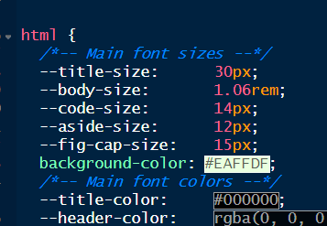
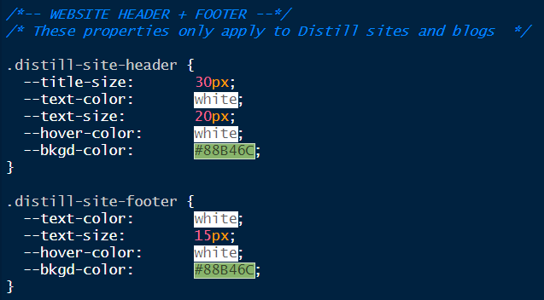
Customising CSS theme file
You can change the aspect of the header and footer here
Add this line of code here to change the site background, set the colour code however you like

Slide 8
Customising the footer
In your repo folder, create a file called _footer.html (same folder as _site.yml and the .rmd pages)
Open with Notepad and write what you want to see in your footer
Save it, it will appear automatically in your website when you push to the cloud

Slide 9
Publishing the site
Commit the changes into GitHub desktop and push to the cloud
Log into Netlify, using your GitHub details
Add new site >> import an existing project >> GitHub >> choose the website repository > choose a name, and put _site in the Publish directory field
Website will automatically update each time you push your changes to the cloud from GitHub desktop

Slide 10
How does it compare with QUARTO + GitHub pages?
Your repository does not have to be public
You don’t need to create a new organisation for each repository you want to make a website from

Slide 11
References
https://posit.co/resources/videos/sharing-on-short-notice-how-to-get-your-materials-online-with-r-markdown/
https://rstudio.github.io/distill/
Lendway (2020, Dec. 18). Lisa Lendway: Building a {distill} website. Retrieved from https://lisalendway.netlify.app/posts/2020-12-09-buildingdistill/

